Slide 1
From the Stadium to the Table:
Analyzing Sports and Dining Trends
Team 108: Akash Kumar, Will Montgomery, Evie Sun, Xiaohu Xu

Slide 2
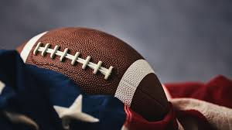
Background & Objectives
• Watching sports and dining at restaurants is a common activity
• Sports culture in America and with regard to the NFL is very strong
• Investigate if there is any correlation between the experience of these two factors
Approach
• Collect win/loss data for relevant sports teams
• Perform sentiment analysis on restaurant reviews
• Compare sentiment trends with sports performance metrics

Slide 3
Research Question ＆ Significance
Main Research Question:
Does the performance of an NFL team in a state correlate with the average sentiment score of sports bars and other football-viewing dining establishments within that state?"
Why It matters:
1.Businesses can strategically time promotions based on team success.
2.Identifies extent of emotional connections between sports performance and consumer sentiment.

Slide 4
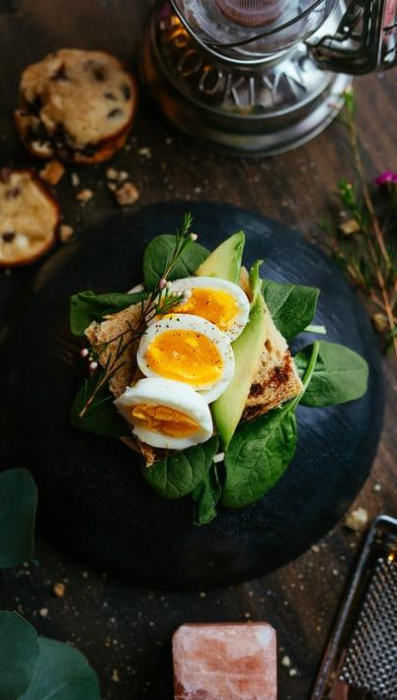
Data Processing
Data Sources:
Sports performance data & restaurant reviews.
• Sentiment score calculation on relevant areas (states in US with one football team)
• Identify restaurants that possess TVs or fit any of the following filters: bar, American, restaurant, beer
• Collected season to season data for NFL team local to state
• Merge data as needed to investigate correlation

Slide 5
Analysis
Methods:
• Used VADER Sentiment Analysis to assign positive, neutral, or negative scores to reviews.
• Statsmodels for regression
• BERT topic modeling
• WordCloud
How This Helps Achieve the Goal?
1.Converts unstructured text data into quantifiable sentiment scores.
2.Enables seasonal sentiment comparison(on-season vs. off-season)
3.Identifies trends that may correlate with NFL team success.
4. See potential year-to-year changes as teams’ performance changes

Slide 6
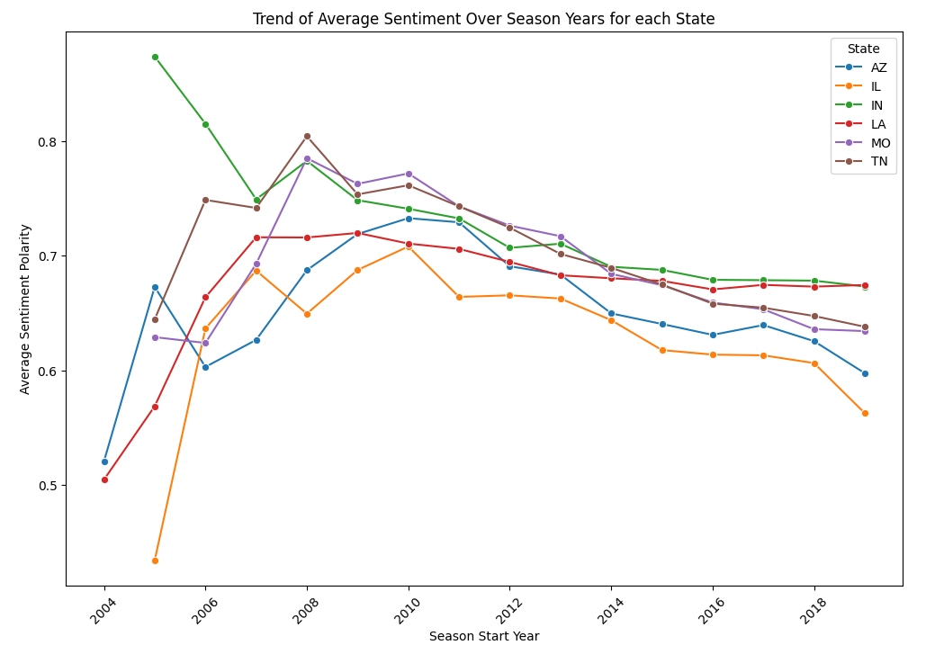
Sentiment Polarity Visualization-Line plot
Trends in customer sentiment changes across different states over the years.

Slide 7
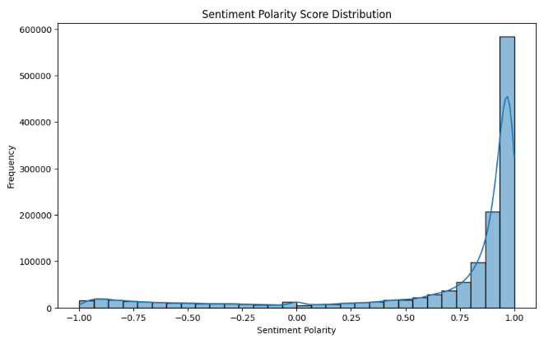
Sentiment Polarity Visualization
The review data is highly concentrated in the 0.75 - 1.0 range, indicating that customers generally have a positive overall evaluation of these sports restaurants.

Slide 8
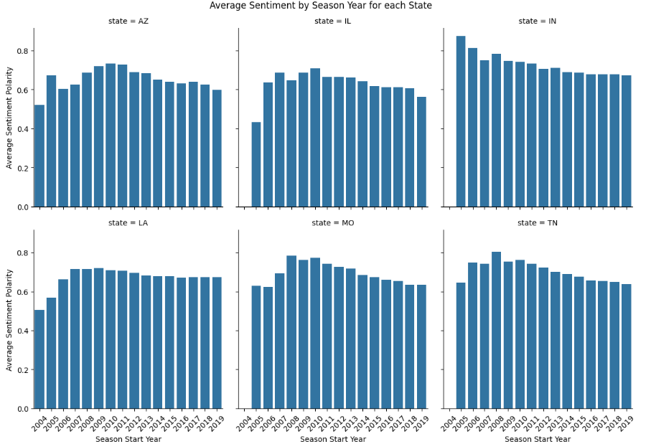
Sentiment Polarity Visualization-Faceted Bar plot
Internal sentiment changes within each state.

Slide 9
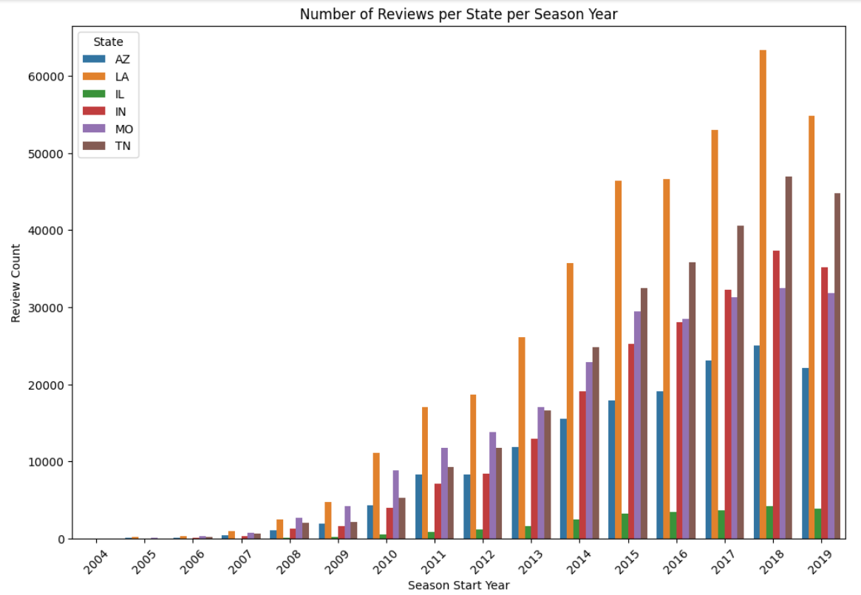
Sentiment Polarity Visualization-Bar plot
Review activity levels across different states.

Slide 10
Analytical Methods
Correlation Analysis:
Tested relationship between win rate and sentiment difference(on-season vs. off- season)
Expected positive correlation (winning teams → higher sentiment).
Regression Model:
Dependent Variable: Sentiment difference (On-Season - Off-Season).
Independent Variables: Win rate playoff progress, and season year.
Topic Model + WordCloud:
Investigate Specific Area
Find highest disparity in win rate in same area, investigate if topics discussed in reviews differed significantly

Slide 11
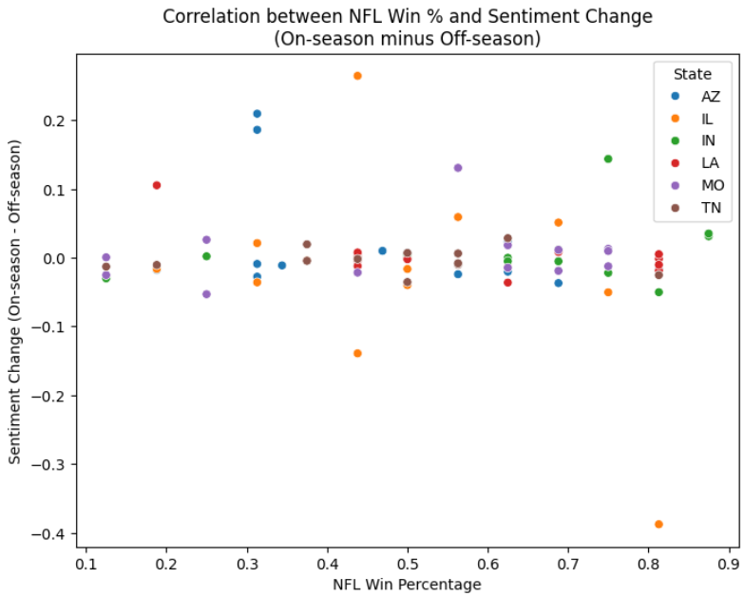
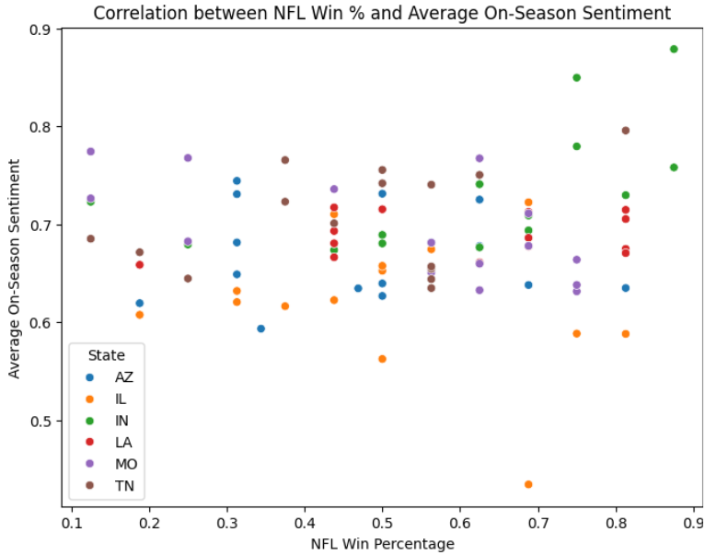
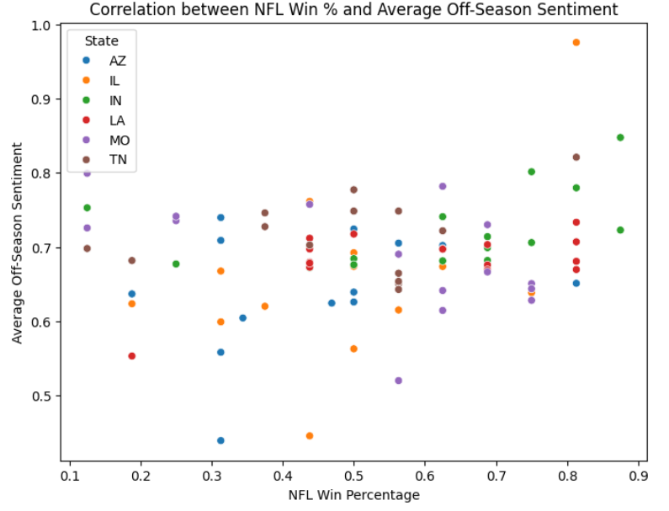
Correlation Analysis Visualization
NFL team win percentage and customer review sentiment change.
NFL team win percentage and average off-season customer sentiment.
NFL team win percentage and average on-season customer sentiment.

Slide 12
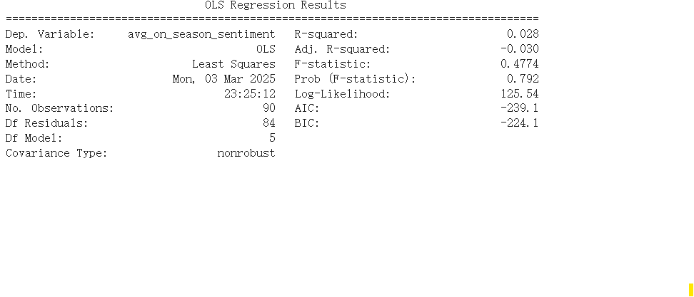
Regression

Slide 13
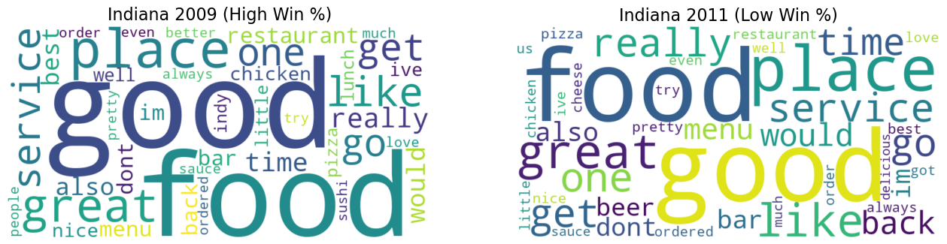
WordCloud

Slide 14
BERT Topic Modeling
Fitting BERTopic model for Indiana 2009 (High Win %)...
Top 10 Topics for Indiana 2009 (High Win %):
Topic Count Name \
1 0 85 0_the_to_and_we
2 1 80 1_sushi_the_and_was
3 2 79 2_the_is_bar_and
4 3 78 3_mexican_the_and_to
5 4 68 4_in_the_you_is
6 5 55 5_pizza_the_and_crust
7 6 51 6_the_and_chinese_of
8 7 40 7_was_the_and_greek
9 8 38 8_breakfast_and_the_pancakes
10 9 34 9_burger_fries_the_burgers
Fitting BERTopic model for Indiana 2011 (Low Win %)...
Top 10 Topics for Indiana 2011 (Low Win %):
Topic Count Name \
1 0 419 0_pizza_crust_is_the
2 1 289 1_sushi_roll_rolls_the
3 2 135 2_burger_burgers_fries_the
4 3 105 3_italian_pasta_was_the
5 4 103 4_we_she_our_to
6 5 100 5_indy_in_indianapolis_is
7 6 78 6_thai_pad_spice_hot
8 7 77 7_chinese_food_is_chicken
9 8 72 8_ribs_bbq_brisket_sauce
10 9 68 9_pho_vietnamese_saigon_beef

Slide 15
Potential Improvements
Allocate more resources to developing accuracy of sentiment scores used in models
Narrow down customer base/restaurant pool to specific sports bars/restaurants (if enough data points exist)
Develop metrics that identify most popular sport in region in question and check correlation to that team

Slide 16
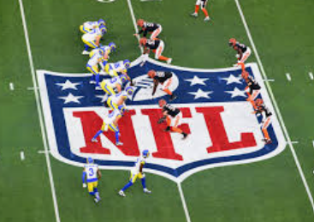
Conclusion
There does not appear to be any correlation between customer sentiment and local NFL team performance.
While the performance of a team is known to affect the mood of fans, they are able to separate this from the restaurant experience.
Businesses should continue to focus on what is within their control (service, quality)

Slide 17

Thank You!

